Slide 1
A Cost-Effective Recommender System for Taxi Drivers
Date : 2014/11/06
Author : Meng Qu, Hengshu Zhu, Junming Liu
Source : KDD’14
Advisor : Jia-ling Koh
Speaker : Sheng-Chih,Chu

Slide 2
Outline
Introduction
Problem Formulation
MNP and rMNP
Experiment
Conclusion

Slide 3
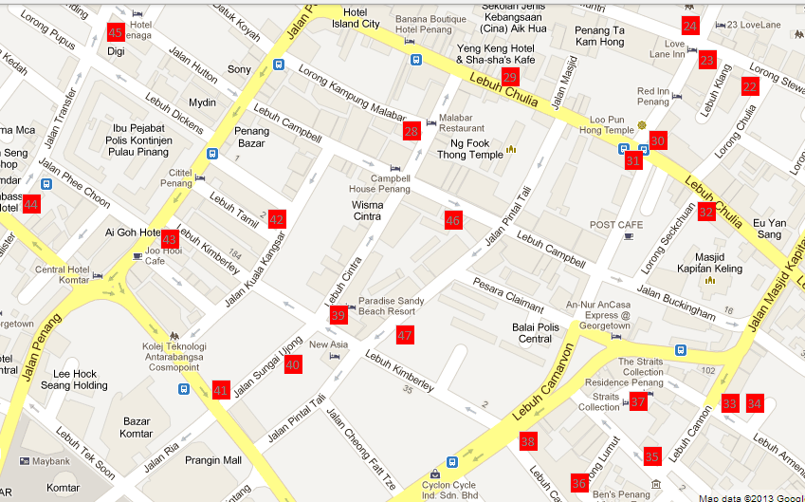

Introduction
Profits ?
Optima routes ?
Effective time ?
1.From start(A) to end(B) -> fast.
2.Give a sequence of pick-up point
-> find customs within shortest distance.

Slide 4
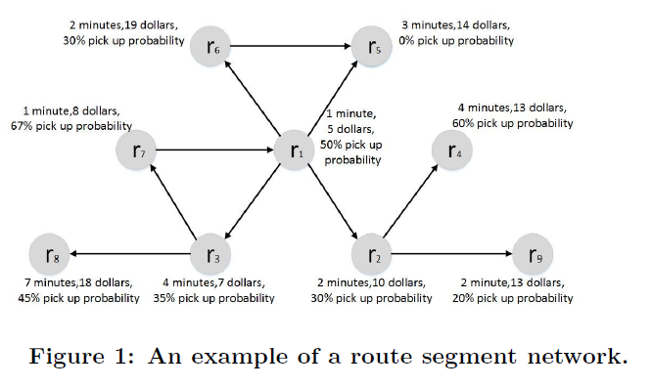
Goal : Maximize profits when following recommender routes for finding a passengers.

Slide 5
Outline
Introduction
Problem Formulation
MNP and rMNP
Experiment
Conclusion

Slide 6
Problem Formulation
R = (r₁->r₂->……->r_{M}), length = M
R.s(start),R.e(end),r_{i}.next[](neighboring point)
s
r1
r2
r3
r4

Slide 7
‣ Calculation of Net profit
Profit g(r) = e(r) – c(r)

Slide 8

‣ example
Assume N_{r} = 2 , i = 1(start),M=3
Protential earn : e(r) , Protential cost : c(r)
If r = r_{1 ,}
e(r₁) = [(Fee(1,1)+Fee(2,1))/2]*P(r₁)
c(r₁) = (1-P(r₁)) *(L(r₁)*Gas+T(r₁).CompanyFee)
G(R,r1,M) = g(r₁)+[g(r₂)*(1-P(r₁))+g(r₃)*(1-P(r₁))*(1-P(r₂))] , total profit

Slide 9
Outline
Introduction
Problem Formulation
MNP and rMNP
Experiment
Conclusion

Slide 10
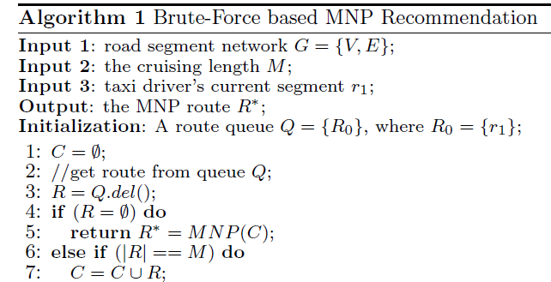
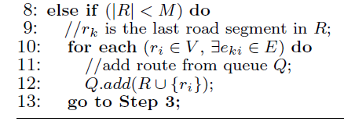
MNP Route Recommendation
Brute-Force Recommendation Strategy

Slide 11
Route net
r₁
r₃
r₂
r₆
r₄
r₅
r₇

Slide 12
Initial : M=3 , root = r₁ , Q = {R₀} , R₀ = {r₁ }
Step 1: R = {r₁ } , if |R| < M
Add Q {r₁ → r₂ , r₁ → r₃ , r₁ → r₄ }
Step 2: R = {r₁ → r₂ } , if |R| < M
Add Q {r₁ → r₂ → r₆, r₁ → r₂ → r₇}
Q state :{r₁ → r₃ , r₁ → r₄ , r₁ → r₂ → r₆ , r₁ → r₂ → r₇ }
Until if |R| == M
Output Candidate routes :
{r₁ → r₂ → r₆ , r₁ → r₂ → r₇ , r₁ → r₃ → r₆ ,
r₁ → r₄ → r₅ , r₁ → r₄ → r₆ }
The computation is too high. O(MN^{M-1})

Slide 13
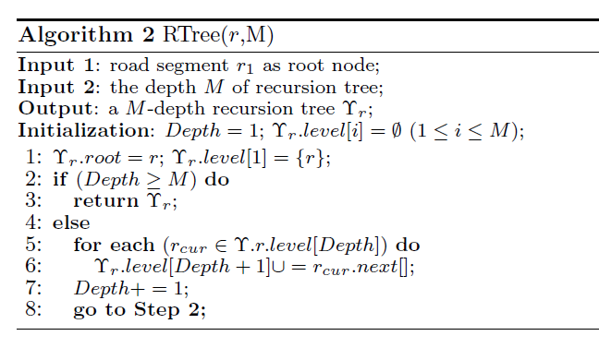
Recursive Recommendation

Slide 14
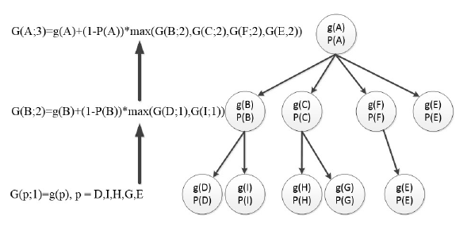

Slide 15
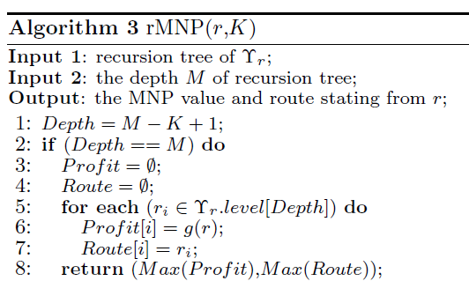
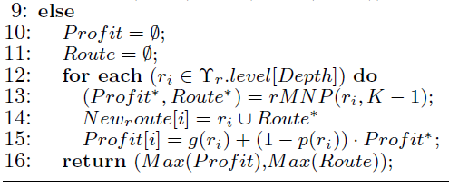
Initial
加入第i層的node,選出max route
Initial
recursive

Slide 16
Example:
G(A;3) = g(A) + (1-P(A)) * max { G(B;2),G(C;2),
G(F;2),G(E;2)}
G(B;2) = g(B) + (1-P(B)) * max {G(D;1),G(I;1)}
G(C;2) = g(C) + (1-P(C)) * max {G(H;1),G(G;1)}
G(F;2) = g(F) + (1-P(F)) * max {G(E;1)}
G(E;2) = g(E) + (1-P(E)) * max {}
G([□;1) = g(□)

Slide 17
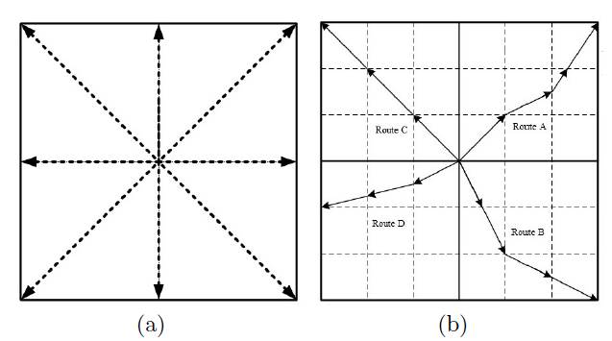
Top-K Route Recommendation
Each grid represent direction vector
(p1,p2,p3,p4……,p8), pi = f_{i}/∑_{(k=1~8)}f_{k}

Slide 18
Outline
Introduction
Problem Formulation
MNP and rMNP
Experiment
Conclusion

Slide 19
Data set
Collected in the San Franciso Bay Area in 30 day.(舊金山灣區)
89897 pick-up and drop-off activites in total
Build Road Network Data with Google Map , GPS Traces and Google API
The dataset contains 5391 roads.(Include ID,starting point,ending point and historical pick-up probability and net profit)

Slide 20
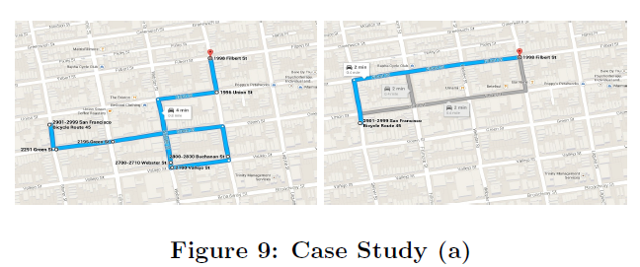
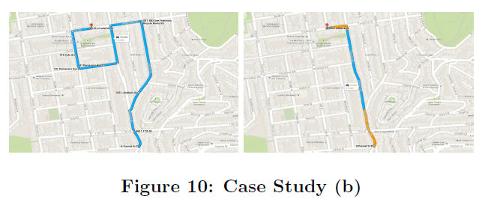

Slide 21
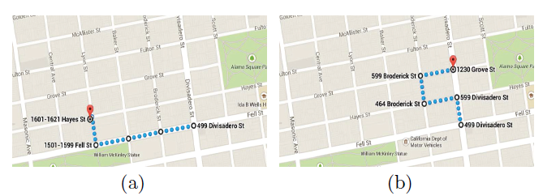
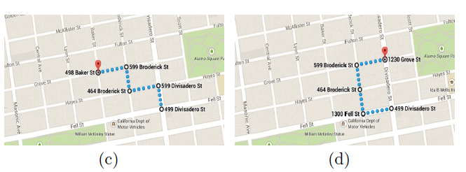
Top-K Recommendation

Slide 22
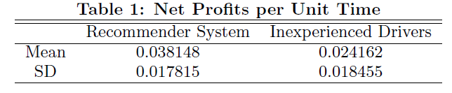
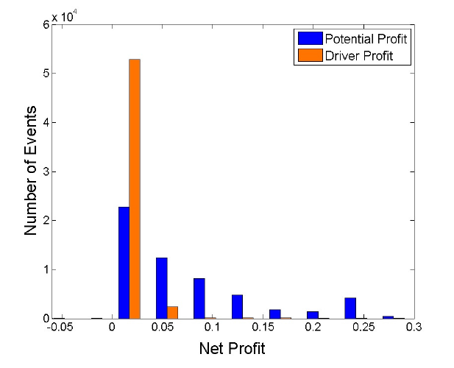
For Inexperienced Taxi Driver

Slide 23
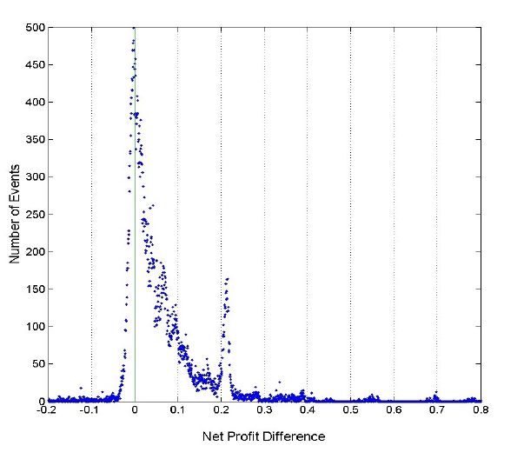
Profit Different

Slide 24
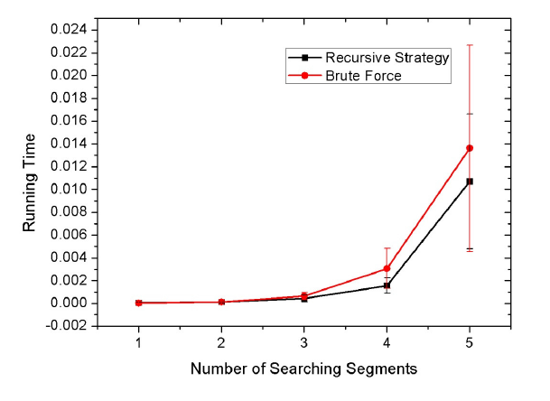
Running Time

Slide 25
Outline
Introduction
Problem Formulation
MNP and rMNP
Experiment
Conclusion

Slide 26
Conclusion
In this paper,Author proposed a cost-efftive recommender for driver to maximize profits by providing profitable routes.
They first provided a net profit objective function before driver finding passenger.
And efficiently gernerate candidate driving routes for different driver.

